Slide 1
Cloud-Native Applications
Lecturer: Ngo Huy Bien
Software Engineering Department
Faculty of Information Technology
VNUHCM - University of Science
Ho Chi Minh City, Vietnam
nhbien@fit.hcmus.edu.vn

Slide 2

Objectives

Slide 3

Contents

Slide 4

References
Dennis Gannon et al. (2017). Cloud-Native Applications.
Rob Vettor et al. (2022). Architecting Cloud Native .NET Applications for Azure. Microsoft Developer Division.

Slide 5
Properties of cloud-native applications [1]
Cloud-native applications often operate at global scale.
Cloud-native applications must scale well with thousands of concurrent users.
They are built on the assumption that infrastructure is fluid and failure is constant. "Infrastructure is fluid" means the system treats hardware and infrastructure resources as dynamically changing, elastic, and disposable, with automation continuously reshaping the environment.
Cloud-native applications are designed so that upgrade and test occur seamlessly without disrupting production.
Security is not an afterthought. Security must be part of the underlying application architecture.

Slide 6
Examples
The Netflix movie streaming service.
Facebook, Twitter, Microsoft Office 365, and many of Google’s cloud collaboration and productivity applications.
There are cloud services upon which cloud-native applications are built that are, themselves, cloud-native. These include Amazon Web Services (AWS) Kinesis streaming and Amazon Redshift, Microsoft Azure CosmosDB and Data Lake, as well as Google BigQuery.

Slide 7
The Technology of Cloud-Native Applications
Microservices
Containers
Service Fabrics (Dynamically orchestrated).

Slide 8
Simple microservice cloud-native application
Suppose you have a mechanism to continuously mine on-line data sources, looking for articles with scientific content.
You want to build a cloud-native application that will use machine learning to characterize and classify the topic of these articles and store this information in a database.

Slide 9
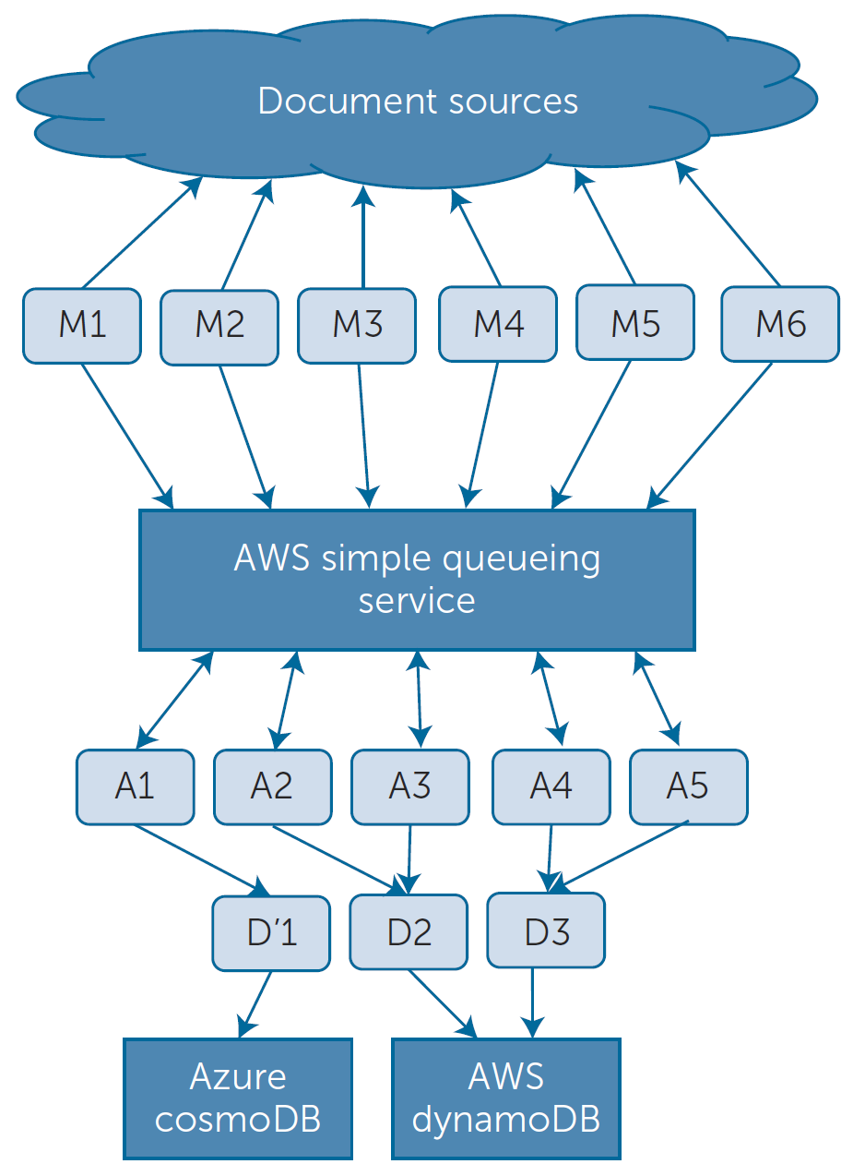
An Application Walkthrough
M1–M6 are the data monitors that skim the relevant RSS feeds and news sites looking for relevant sounding articles.
A1–A5 are analysis services and D1–D3 are database managing services.
There is an important additional observation about this example. It is not based purely on microservices because it includes the AWS simple queue service and two database services.

Slide 10


Slide 11
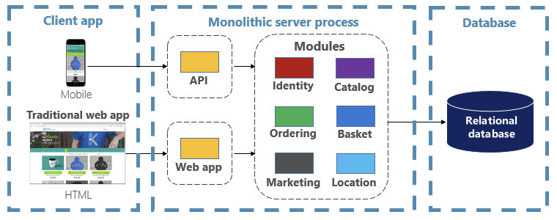
Monolith eCommerce [2]
New technologies and frameworks aren't an option.
New features/fixes become tricky, time-consuming, and expensive to implement.

Slide 12
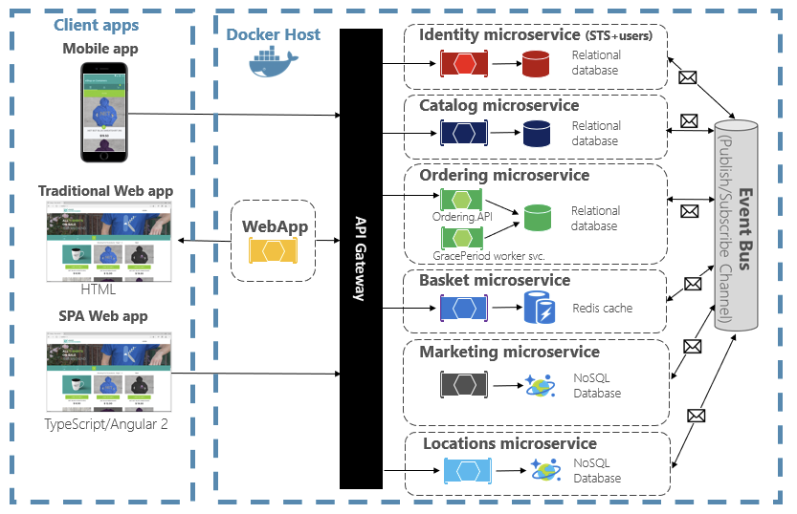
Cloud-Native Design

Slide 13
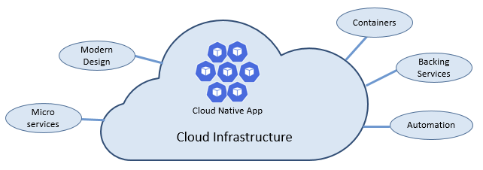
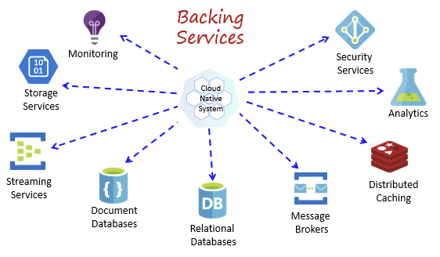
The Pillars of Cloud Native

Slide 14
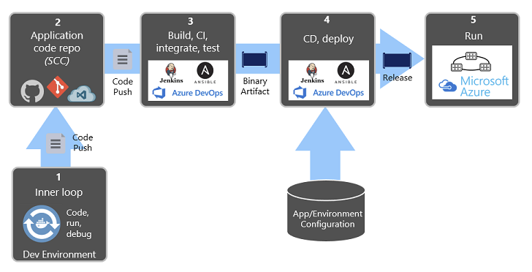
Automating Deployments

Slide 15
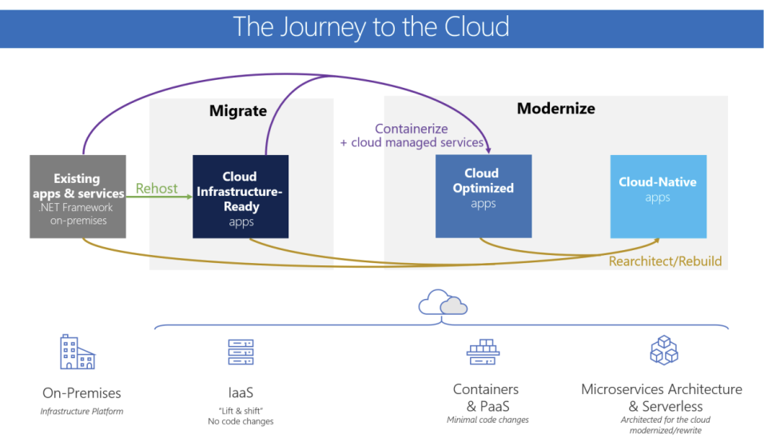
Modernizing Legacy Apps

Slide 16

Thank You & See You Again

